Slide 1

colloid and surface chemistry
Dr. Péter Bohus

Slide 2

definitions

Slide 3
Definition of Colloid
Any particle that has some linear dimension between 10⁻⁹-10⁻⁶m is considered a colloid.
The linear dimension is size range, rather than particle weight or the number of atoms in a particle.
The properties of colloid system and surface phenomena of colloid system depend mainly on the specific surface area of colloid particle, little or lightly on the colloid structure and density of a particle.
10⁻⁶ m < 10⁻⁹-10⁻⁶m < 10⁻⁹m
large dispersion < colloid < solution

Slide 4
Surface and Interface
A surface has area but not thickness (or thickness limits to zero).
The word surface is used in the chemical sense of a phase boundary rather than in a strictly geometrical sense.
An interface has area and thickness.
There is an interface between two phase, the thickness usually about molecular dimensions
But surface and interface normally alter each other, as a same term (especially in China).

Slide 5
Other Concepts and Classification of Colloid
Macromolecular colloid
Multiphase dispersion
Stability
Aggregate
Size and shape of colloidal particle

Slide 6
Micelle
A monophasic, fluid, transparent, isotropic and thermodynamically stable system composed by surfactant and water, the particle has some linear dimension between 10⁻⁹-10⁻⁶m.
O/W micelle

Slide 7
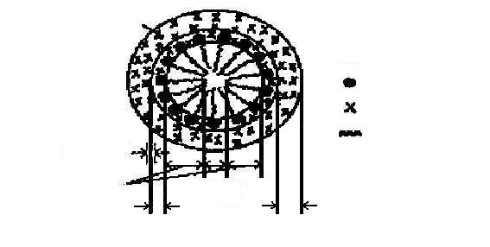
O/W micelle structure
solvent layer
interface
diffusion double-layer

Slide 8
Emulsion
A multiphasic, no-transparent and thermodynamically unstable system composed by surfactant, cosurfactant, oil and water.
Microemulsion
A monophasic, fluid, transparent, isotropic and thermodynamically stable system composed by surfactant, cosurfactant, oil and water.
For microemulsion, the three-component system of surfactant, cosurfactant and water usually presents some similar properties to the four-component system of surfactant, cosurfactant, oil and water.
Thus the three-component system is often used as the basic system of microemulsion to study the properties of microemulsions.

Slide 9
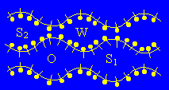
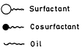
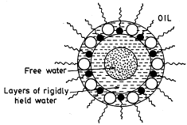
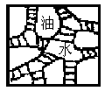
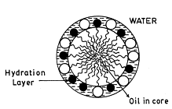
O/W structure
Microemulsion
W/O structure
Bicontinuous structure

Slide 10
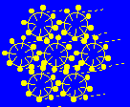
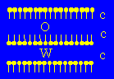
Lamellar liquid crystal
Lyotropic liquid crystal
Hexagonal liquid crystal (Cubic liquid crystal)
Reverse hexagonal liquid crystal

Slide 11
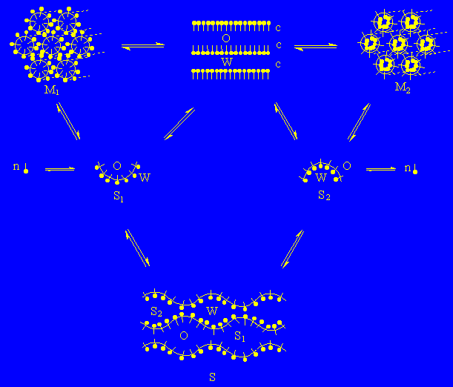
The exchange of main structures of aggregation

Slide 12
Impact of Colloid and Surface Chemistry in Science, Engineering and Technology
Analytical chemistry
Physical chemistry
Biochemistry and molecular biology
Chemical manufacturing
Environmental science
Material science
Petroleum science, geology, soil science
Household and consumer products
Imaging technology

Slide 13
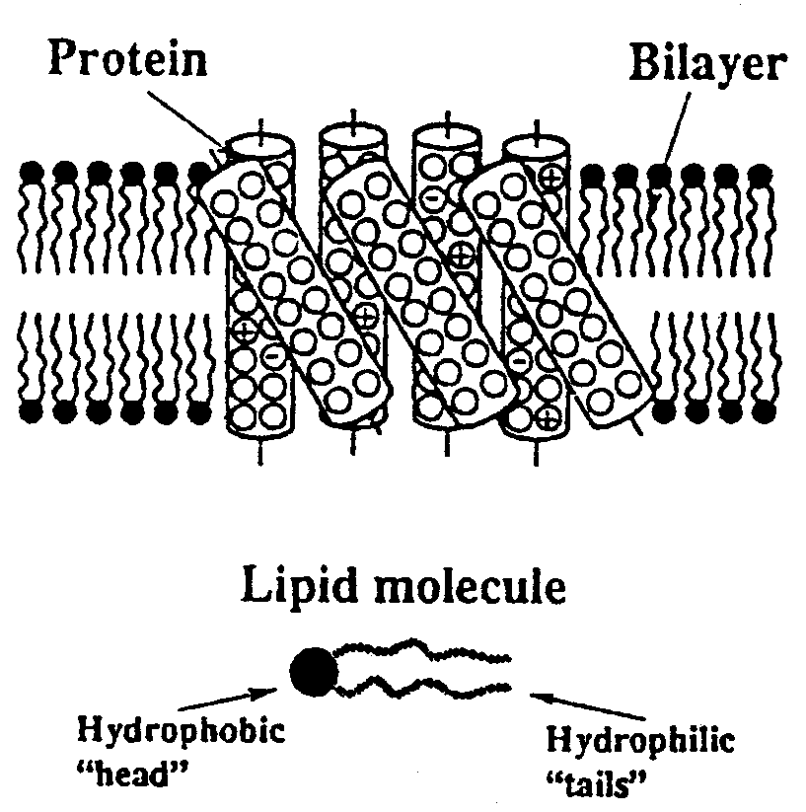
Biological membranes and cells

Slide 14
The Importance of the Surface for Small Particles
Increase in surface area and energy with decrease in size
A = 4πR²
V = (4/3)πR³
Supposing, the density of any sphere is same after n “cut”. But, in fact, the density depends not only on the mass and volume of the molecules, but also on their packing in a bulk sample.
Therefore, increase in surface area and energy with decrease in size.

Slide 15
Specific Surface Area
For a fixed amount of material, the specific surface area is inversely proportional to the radius for uniform, spherical particles.
A_{sp} = A_{tol} /m_{tol}
= (n 4πR²)/[n(4/3)πR³ρ]
= 3/Rρ

Slide 16
Specific Surface Area
The actual system consists of non-uniform spheres, an average value of the radius may be evaluated.
If the particles are nonspherical (or irregularly shaped particles), a quantity known as the radius of an equivalent sphere may be extracted from experimental A_{sp} values.

Slide 17
For cylindrical particle
The sum of the area of both ends and the cylindrical surface:
A = 2(πR²) + 2πRL
A_{sp} = A_{tol} /m_{tol}
= n(2πR²+2πRL)/[nπR²Lρ]
= (2/ρ)(1/R+1/L)

Slide 18
Specific Surface Gibbs Energy (Surface Tension)
γ = (∂G/∂A)_{T,P} = (∂U/∂A)_{S,V}
= (∂H/∂A)_{S,P} = (∂F/∂A)_{T,V}
= Force/Length
Unite: J·m⁻²
Total Surface Energy:

Slide 19
Classification of Colloids Based on Affinity to Carrier Fluid
1. Continuous Phase and Dispersed Phase
Continuous phase refers to the medium.
Dispersed phase refers to the particles in the colloid range.
The words continuous phase and dispersed phase refer to the medium and to particles.
2. Lyophilic Colloids
Lyophilic means “solvent loving”
Lyophilic colloid refers to soluble macro- molecular materials in which the individual particles (to be of colloid dimensions).
Macromolecular colloids are true solutions and stable system in the thermodynamic sense.
There is no clearly interface between the continuous phase and the dispersed phase (individual particles).

Slide 20
Classification of Colloids Based on Affinity to Carrier Fluid
3. Lyophobic Colloids
There are clearly interfaces between the continuous phase and the dispersed phase (colloid particles), i.e. the presence of two-phase.
The common feature of all the system we consider is that some characteristic linear dimension of the dispersed particles falls in the range defined (10⁻⁷-10⁻⁹ m).

Slide 21
Summary of some of the descriptive names used to designate two-phase colloidal system
Continuous phase | Dispersed phase | Descriptive name
Gas | Liquid | Fog, mist, aerosol
Gas | Solid | Smoke, aerosol
Liquid | Gas | Foam
Liquid | liquid | Emulsion
Liquid | solid | Sol,colloidal sol., gel,suspension
Solid | Gas | Solid foam
Solid | Liquid | Gel, solid emulsion
Solid | Solid | Alloy

Slide 22
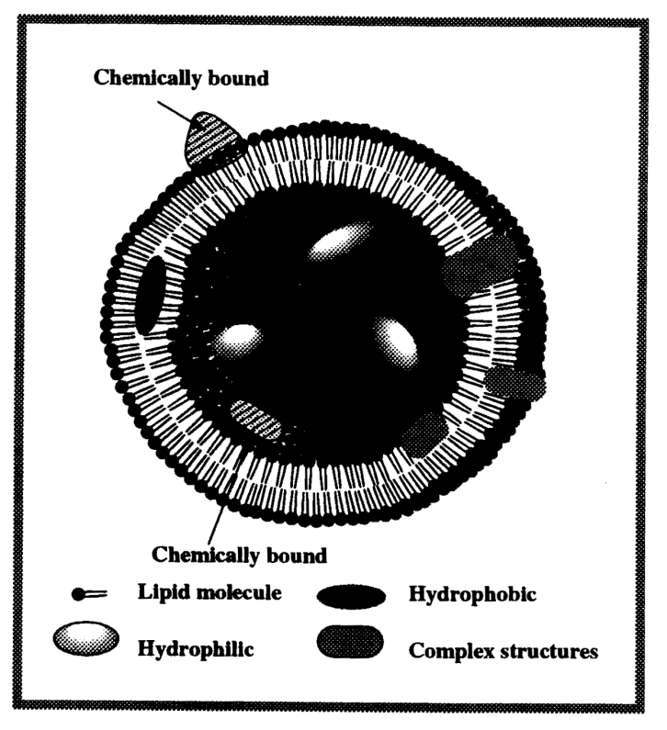
Lyophobic means “liquid repelling’
Lyophobic Colloids are unstable in thermodynamically, but stable kinetically.

Slide 23
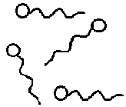
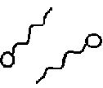
Critical micelle concentration (CMC)
The concentration of the micellization occurs just or just makes micelle formation very like a phase separation.
or
Micellization schematic diagram

Slide 24
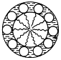
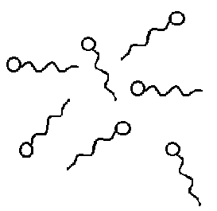
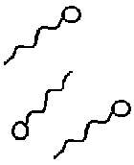

Slide 25
Concept of stability of colloidal system
The stability is relative, the instability is absolute.
1. Kinetic stability
Kinetic stability = diffusion + diffusion equilibrium + stability
Because chemical reactions do not usually occur in colloidal system, colloids are stable system in kinetic.
The coarsening process of a thermo-dynamically unstable dispersion is called coalescence or aggregation.
Coarsening process = coalescence + aggregation

Slide 26
Coarsening process
Coalescence: the process that many small particles take together to form a new big particle, total surface area of the dispersion system decreases.
Aggregation: the process by which small particles clump together like a bunch of grapes (an aggregate), but do not fuse into a new particle, total surface area of the dispersion system do not decrease as well.
When aggregation, the small primary particles retain their origin identity, only their kinetic independence is lost. Aggregate moves as a single unit.

Slide 27
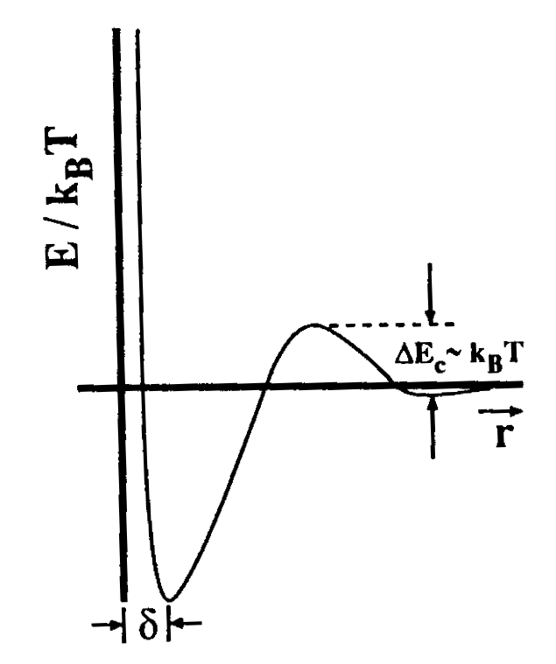
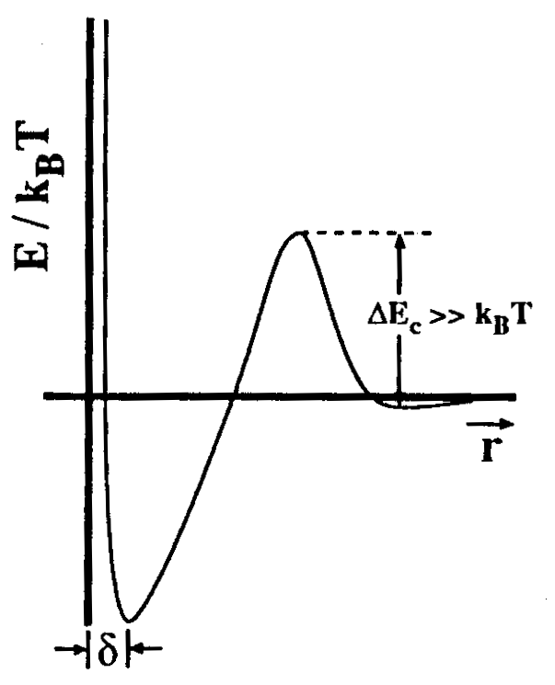
Schematic illustration of kinetic of colloids
Kinetically Unstable
Kinetically stable

Slide 28
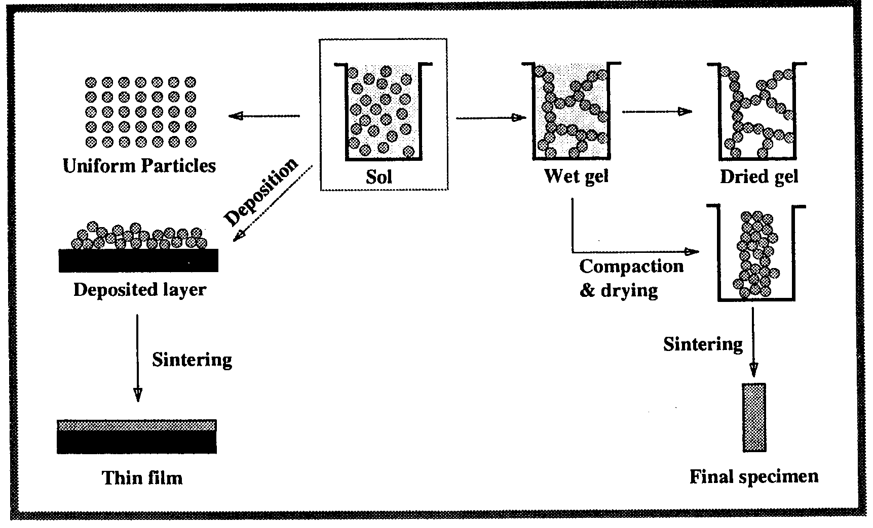
Schematic diagram of colloidal processing of ceramic specimens

Slide 29
Concept of stability of colloidal system
2. Thermodynamic stability
Thermodynamic stability: The Gibbs energy of the micellization of surfactants molecule is less than zero.
So, the processing of the micellization of surfactants molecule is spontaneous.
Note: The stability of a colloidal system relates with many facts, i.e. surfactant concentration, surfactant properties, temperature, pH, electrolyte, medium, co-surfactant, etc.

Slide 30
Some Physical Characteristics of colloids
1. Particle Size and Shape
Monodisperse and polydisperse system
Monodisperse system: Particle Size and Shape are unique. It is characterized by a single parameter.
Many solid particles of this system are actually spherical, and are characterized by a high degree of symmetry like a sphere and are often approximated as spheres.
Polydisperse system: Particle Size and Shape are various, remarkably different in shape and size.

Slide 31
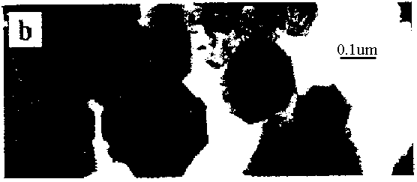
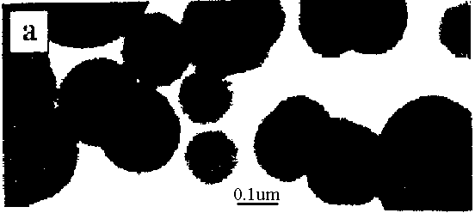
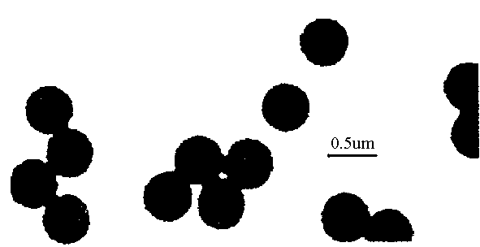
Electron micrograph of
monodisperse system
Electron micrograph of
carbon black particles

Slide 32
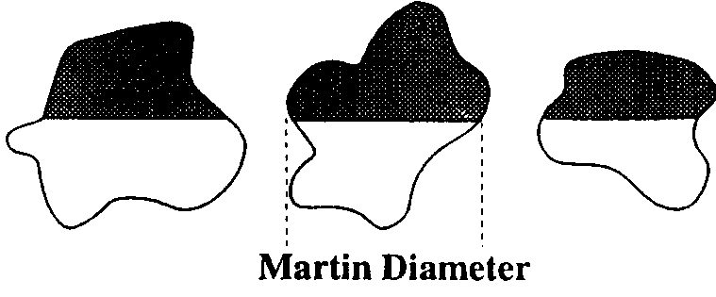
Some Physical Characteristics of colloids
2. Martin Diameter
The length of a line that bisects the projected area of a particle is a parameter know as Martin diameter.
The direction along which the Martin diameter is measured is arbitrary, but it is should be used consistently to avoid subjective bias.

Slide 33
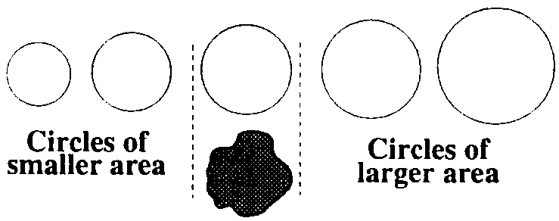
Some Physical Characteristics of colloids
3. Graticule Diameter
For irregular particles, graticule diameter is a diameter of the circle that by an assortment of circles of different sizes etched on a trans-parent slide in to the eyepiece of a microscope and deciding which circle most closely approxi-mates the projected area of the particles.

Slide 34
Some Physical Characteristics of colloids
4. Ellipsoid of revolution
For the particles with a low degree of symmetry, An ellipsoid of revolution is the three-dimensional body that results from the complete rotation of an ellipse around on of its axes.
We define a as the radius of the ellipsoid measured along the axis of rotation, and b as the radius measured in the equatorial plane.

Slide 35
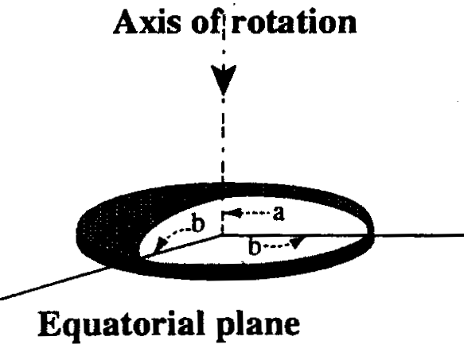
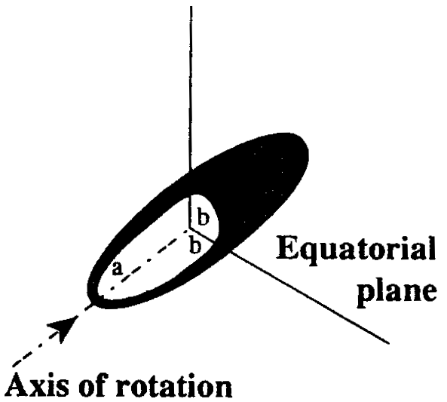
Ellipsoid of revolution
If a>b, the particle is called a prolate ellipsoid.
If a<b, the particle is called an oblate ellipsoid.

Slide 36
Ellipsoid of revolution
If a>b, the particle is called a prolate ellipsoid.
If a<b, the particle is called an oblate ellipsoid.
a/b is called the axial ratio of the ellipsoid
If a/b<<1, the oblate ellipsoid approaches the shape of a disk.
If a/b>>1, the prolate ellipsoid approaches a cylinder or rod-shaped particle.

Slide 37
Some Physical Characteristics of colloids
5. “Model particles” of various shapes and sizes
To control the shapes and sizes of the particles to produce “model” particles that can be used to study properties old colloids and to develop new uses for colloid.
“model colloids” are illustrated by the following partial list

Slide 38
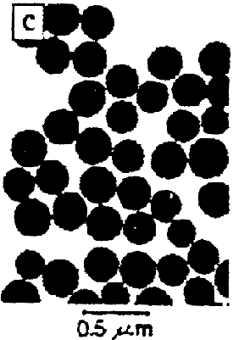
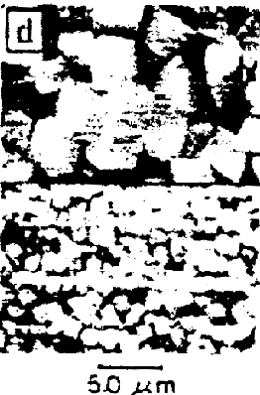
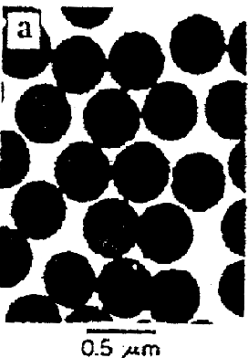
Spherical and cubic particles with crystalline or amorphous microstructure

Slide 39
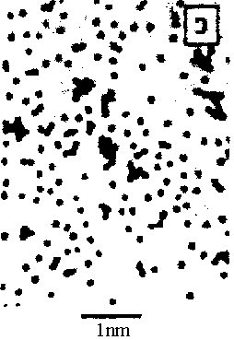
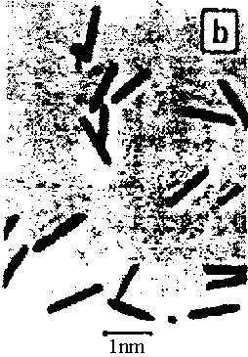
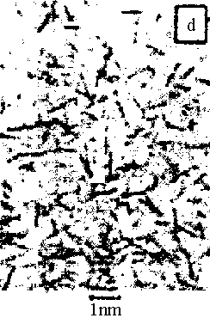
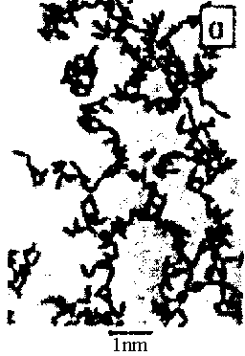
Model particles of different shapes with the same or different chemical compositions

Slide 40
Some Physical Characteristics of colloids
6. Particle Aggregation
In many situations, the dispersed phase is present as aggregates, not as primary particles. In such cases, it is the size, shape, and con-centration of the aggregates that determine the properties of the dispersion itself.
The size and the shape of the aggregates are obtained normally by transmission electron microscopy (TEM) or scanning electron microscopy (SEM).

Slide 41
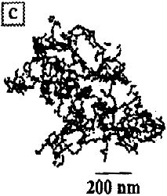
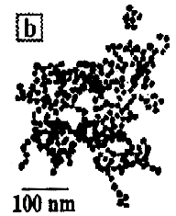
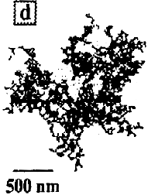
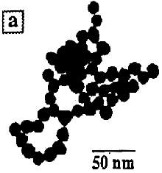
TEM of aggregates of gold particles

Slide 42
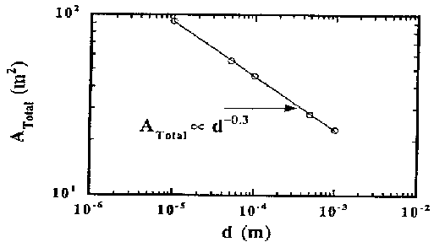
Aggregates obtained through computer simulations

Slide 43
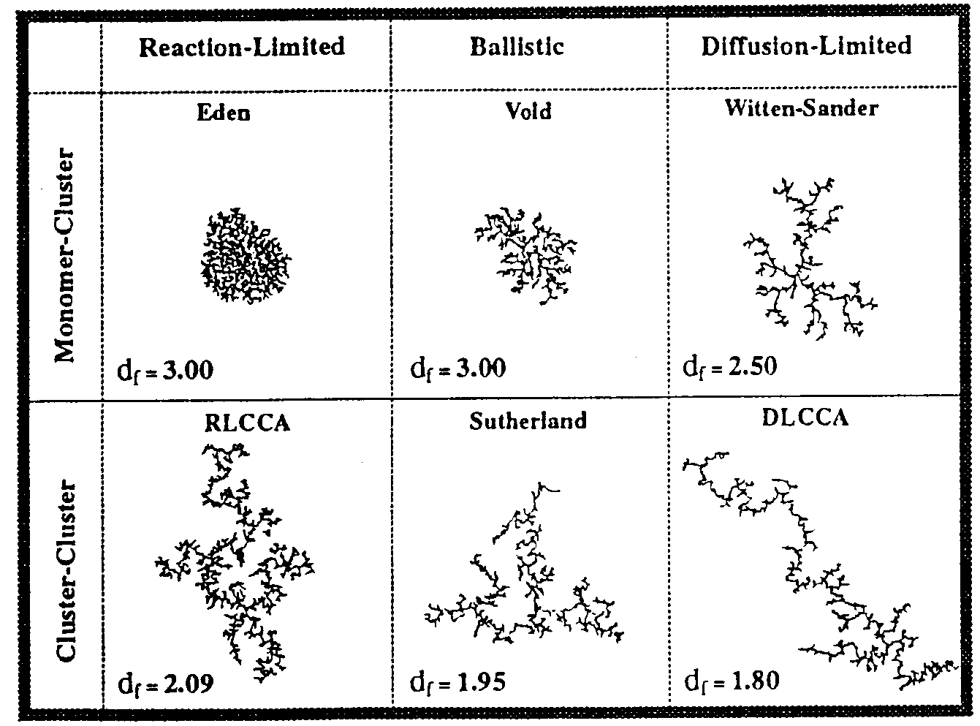
Some Physical Characteristics of colloids
7. Statistical analysis of polydispersed colloid
A brief theoretical distribution functions of statistical analysis is given in Appendix C for polydispersed colloid.
An experiment distribution functions of statistical analysis is given in this figure.

Slide 44
Average diameters and standard deviation
name | symbol | definition | Quantity average
Number average or mean |  |  | diameter
Second moment About origin |  |  | Square of diameter
Surface average |  |  | Square of diameter
Volume average |  |  | Cube of diameter
Third moment about origin |  |  | Cube of diameter
Radius of gyration |  |  | Square of radius

Slide 45
Average diameters and standard deviation
Note: the relative magnitudes of the number, surface and volume average diameters are given by the sequence for a polydisperse:
Only for a monodisperses system would all three parameters have identical values.
<
<

Slide 46
Molecular weight averages
name | symbol | definition | Methods
Number average molecular weight |  |  | Osmotic press, other colligative properties
Number average molecular weight |  |  | Light scattering, sedimention velocity
viscosity average molecular weight |  |  | Intrinsic viscosity
≥ 1 for a polydispersed system.

Slide 47
§1.6 Some Classical and Emerging Experimental Tools
For measurement of sizes and for surface force measurements, to present a few examples of instruments available for visual observation and imaging of colloid and surfaces.

Slide 48
1. Optical microscopy
(1) contrast
For a particle to be visible optically, there must be an acceptable different its refractive index and that its surroundings. This is known as contrast.
The contrast between a particle and its surrounding arises depends on the radiation and probing technique used.

Slide 49
(2) Optical principle of an optical microscope
A beam of light is always diffracted at the edges of an object to produce a set of images of the edge known as a diffraction pattern.
We know from physic, positive reinforcement through diffraction occurs whenever such an extra distance equals some integral number of wavelengths of light.

Slide 50
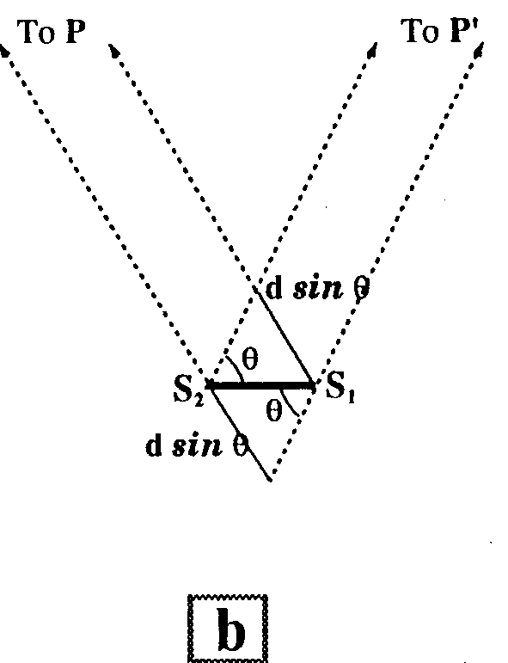
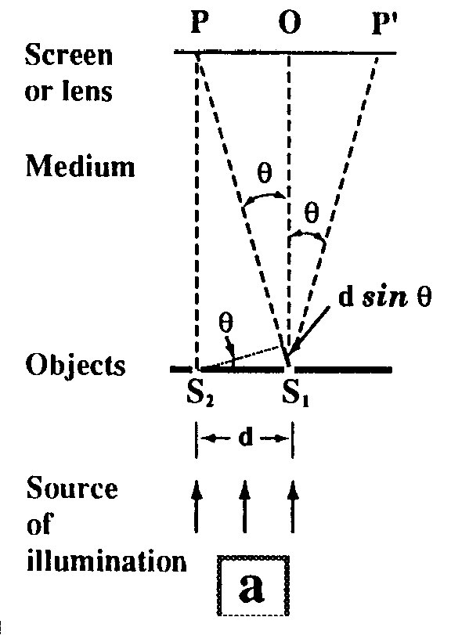
Fig. 1.19

Slide 51
For first-order diffraction, it must be obeyed by Bragg equation:
To be intercepted by the lens and thereby become part of the image, rays from different parts of the source must travel paths that differ by 2dsinθ.

Slide 52
The resolving power d is defined to be the magnitude of the separation between objects that is required to produce discernibly different images.
NA is called the numerical aperture of the lens.
The signification of above equation: any points closer together than the distance d will produce a first-order diffraction image with light having a wavelength equal to λ/n at some angle greater than θ.

Slide 53
Above equation shows that the resolving power is decreased by increasing θ or by decreasing λ/n.
But, the subtended angle 2θ is increased by increasing the diameter of the lens and by decreasing the distance between the object and the lens, the design of the lens limits the range of theses parameters. The ratio λ/n may be decreased by decreasing λ or by increasing n.

Slide 54
As a example, if λ=500nm, n = 1.5 (immersion oil), and 2θ = 140º, the resolving power d = 142nm. This result represents the power limit of resolved particle size under completely idea circumstances.
Under closer too average circumstances, a figure twice this value (d = 142nm) may be more typical.

Slide 55
These results reveal that direct micro-scopic observation is feasible only for particles at the upper end of the colloidal size range and then only if the particle contrasts sufficiently in refractive index with its surroundings.
This is the reason for exploring the use of other radiations such as X-ray and neutron and other techniques to “visualize” submicroscopic particles and features of interest in colloid science.

Slide 56
(3) Dark-field microscopy
By dark-field microscopy, particles as small as 5nm may be detected under optimum conditions, with about 20nm as the lower limit under average condition.
In dark-field microscopy, the sample is illuminated from the side rather than from below as in an ordinary microscopy.

Slide 57
If no particles are present, no light would be deviated from the horizontal into the microscope, and the field would appear totally dark. However, the present of small dispersed particles leads to the scattering of some light from the horizontal into the microscope objective (sometimes called the Tydall effect).
In dark-field microscopy, some rough indication of the symmetry of the particles is afforded by the twinkling that accompanies the rotation of asymmetrical particles ,but this is a highly subjective observation.

Slide 58
In dark-field, as in direct observation microscopy, the refractive index difference between the particles and the medium is one of the crucial factors that influences the feasibility of the method.
Very good resolving power is obtained with metallic particles, which offer maximum contrast refractive index. The technique played an important historic role in colloid science, particularly in the study of metallic colloids.
R. Zsigmondy (Nobel Prize, 1925) made extensive use of this technique in his study of colloidal gold.

Slide 59
2. Electron microscopy
(1) Transmission Electron Microscopy (TEM)
It is clear that the best prospect for extending the range of microscopy lies in the extension by orders of magnitude of the wavelength used to produce the image.

Slide 60
According to the de Broglie equation:
λ = h/mν
The wavelength of a particle is inversely proportional to its momentum.
In an electro microscopy, a beam of electrons replaces light in producing an image.
An electron beam is produced by a hot filament, accelerated by an electron gun, and focused by electric or magnetic fields that function as lenses.

Slide 61
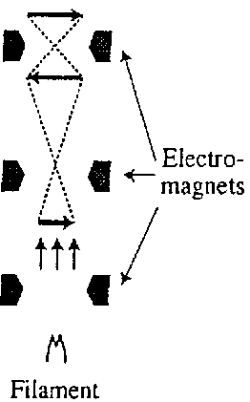
Basic principle of electro microscopy
If the electron beam is the trans-mitted electron beam, the method is called transmis-sion electron microscopy (TEM).

Slide 62
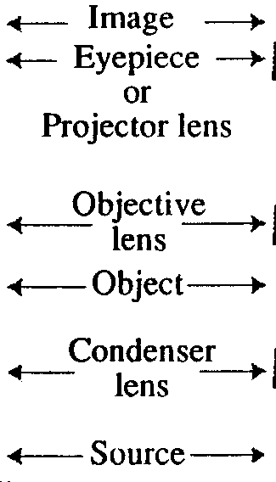
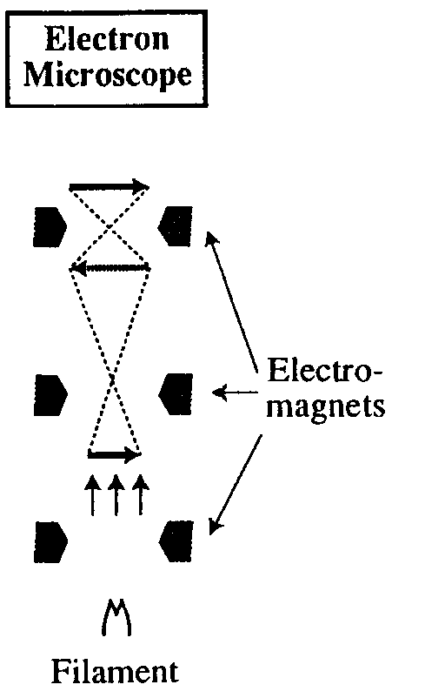
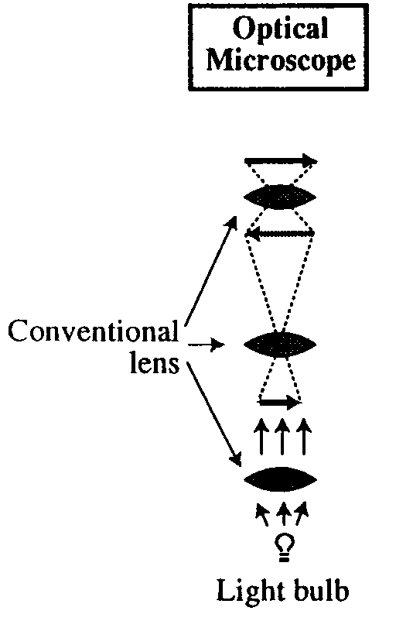
Schematic comparison of light and electron microscopy
light microscopy
electron microscopy

Slide 63
Note: The intensity of the electron beam that is transmitted through the specimen in an electron microscopy depends on the thickness of the sample and the concentration of atoms in the sample. And the contrast difference of image depends also on the characteristics between the particles of the sample and the support on which they rest (i.e. medium).
The low-contrast situation leads to a poor-quality image, which looks as a (white) needle on a white page.

Slide 64
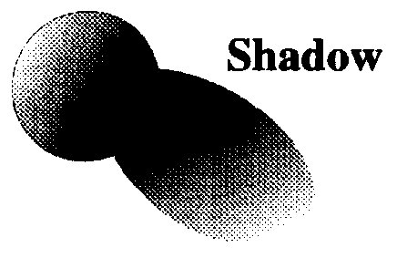
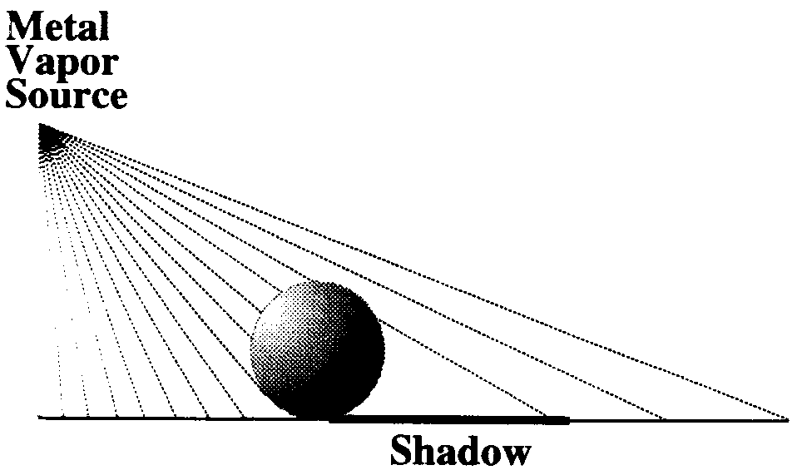
(2) Shadow casting
The most common way of overcoming the low-contrast situation is by the method of a technique known as SHADOW CASTING.
Fig. 1.21 Shadow casting

Slide 65
Therefore, with shadow casting, the image shows much more detail. The particle size and shape and some behaviors or properties can be obtained if the particle is observed from more anger sides.
The length of the shadow cast by a spherical reference particle may be used as a standard to calculate the thickness of particles.

Slide 66
Comparison of application of light and electron microscope:
The light microscope is limited in range, but the electron microscope clearly has access to the entire colloidal size range.
A very real disadvantage persists even with the conventional electron microscope: TEM and SEM require that the sample be placed in an evacuated enclosure for examina-tion by the electro beam. The result bears about as much resemblance to the original dispersion.

Slide 67
(3) Scanning electron microscopy (SEM)
The technique is most used to surface analysis, combined with spectroscopic methods.
In contrast to the TEM, the SEM works somewhat like a TV cathode-ray tube. An electron gun is used to scan a surface with the help of deflection coils and focusing “lenses” in a raster pattern, and the “reflected”electron single is used synchronously to generate an image of very high magnification on a screen.

Slide 68
(4) Scanning tunneling microscopy (STM)
When a probe , usually a metal tip down to the size of an atom, is brought to within a nanometer from the surface of a conductor or a semiconductor, electrons can be made to jump from the surface to the tip by applying what is bias potential, called the tunneling effect. The resulting current is known as the tunneling current (P55).

Slide 69
By keeping the tunneling current constant as one moves the probe along a surface, one can follow the surface contour with atomic-scale precision.
In the constant current mode of operation, the vertical displacement of the probe can be mapped with angstrom- level precision using the deflections of the piezo-electric ceramic piece on which the metal tip is mounted. The data can be converted to images to allow one to see the surface.

Slide 70
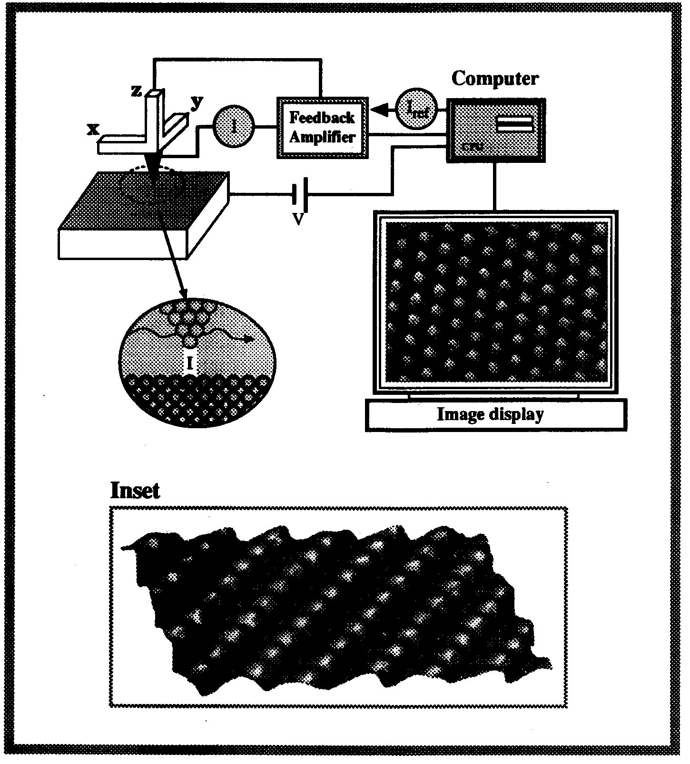
Fig. 1.22 One type of operation of STM

Slide 71
(5) Scanning probe microscopy (SPM)
The atomic force microscopy (AFM), one type of scanning probe microscopy , can be used to measure forces such as Van der Waals forces, ion-ion interaction, hydration forces on polymer-coated surfaces, biologi-cally relevant bilayers, and so on (P55).
In the force-measuring mode, an SPM is often referred to as a surface force microscope (SFM), but the label APM signifies the more general capability of these devices (P54-55).

Slide 72
3. Size and molecular weight measurement
(1) Particle size measurement
Main methods: Optical microscopy, Electron microscopy (TEM, SEM, SPM, AFM, STM), static light scattering, dynamic light scattering, chromatographic technique, field-flow fractionation method, NMR, SMR, and so on.

Slide 73
(2) Molecular weight
Main methods: static light scattering, dynamic light scattering, chromatographic techniques, field-flow fractionation method, NMR, SMR, viscosity, and so on.
(3) Force measurement
A. Indirect methods: adhesion, peeling, UV, contact angle, adsorption, optical techniques, NMR (nuclear magnetic resonance), light scattering, X-ray scattering, neutron scattering, and so on.

Slide 74
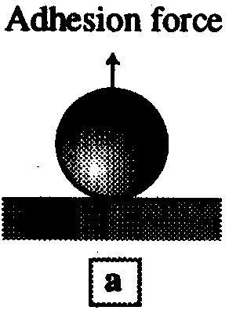
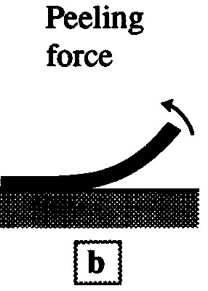



Fig. 1.26 (a-e) Indirect methods

Slide 75
B. Direct methods: optical techniques, Electron microscopy (TEM, SEM, SPM, AFM, STM), NMR (nuclear magnetic resonance), light scattering, X-ray scattering, neutron scattering, surface tension, interface tension, viscosity, and so on.

Slide 76



Fig. 1.26 (g-h) Indirect methods

Slide 77

Fig. 1.27 SFM measurement

